Slide 1
Lessons learned from assessing the water-food-energy-ecosystems nexus: approaches, findings and possible response actions
Side event 5
Central Asian Environmental Forum
Ashgabat, 7 June 2017
Mr. Peep Mardiste
Regional coordinator
EUWI National Policy Dialogues
UNECE

Slide 2
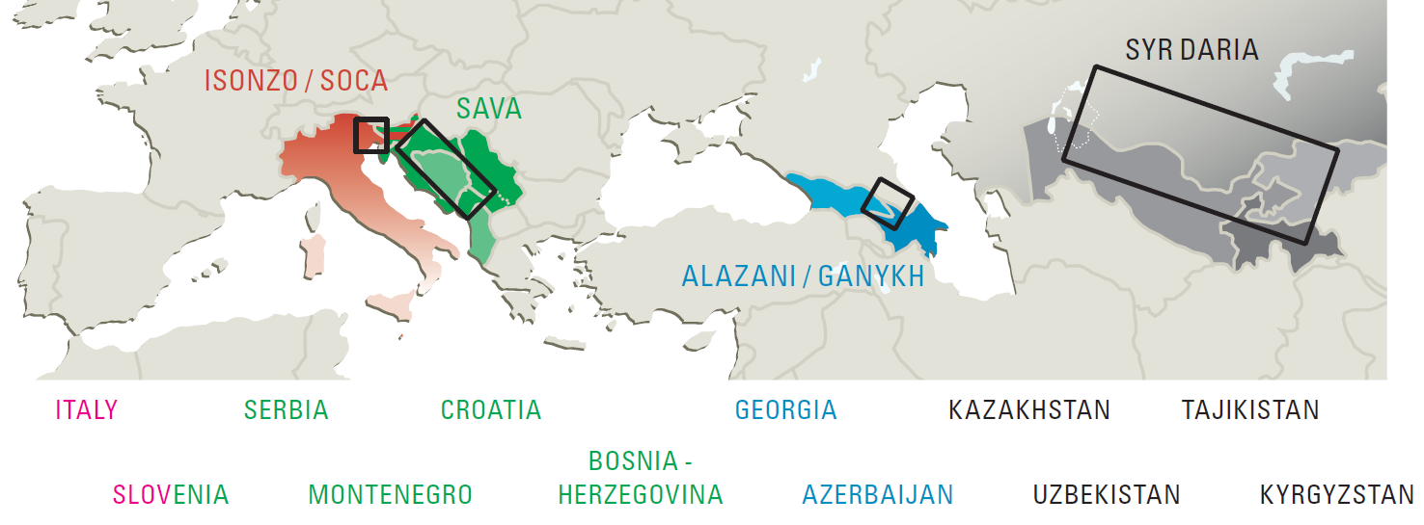
Nexus assessments under the UNECE Water Convention: the framework, 1/2
A part of the Programme of Work 2013-2015 under the UNECE Water Convention (a global instrument); continues 2016-2018;
Assessed: Alazani/Ganykh, Sava, Syr Darya, Isonzo/Soca; Drina; starting – North-Western Sahara Aquifer
Notes:
Foster transboundary cooperation by:
Identifying intersectoral synergies that could be further explored and utilized;
Determining policy measures and actions that could alleviate tensions or conflicts related to the multiple uses of and need for common resources.
The nexus assessment also aims to
Assist countries to optimize their use of resources, increase efficiency and ensure greater policy coherence and co-management;
Build capacity to assess and address intersectoral impacts.

Slide 3
Nexus assessments under the UNECE Water Convention: the framework, 2/2
Task Force on the Water-Food-Energy-Ecosystems Nexus established to guide the work and to provide oversight; close cooperation with the Sustainable Energy Division
Aims: Foster transboundary cooperation (intersectoral synergies & measures to reduce tensions); assist countries (resource use optimization, capacity building);
assessments prepared in close cooperation with and reviewed by the national administrations;
Meeting of the Parties endorsed the methodology and general conclusions (November 2015)
ENERGY
CLIMATE and
ENVIRONMENT
ECOSYSTEM
SERVICES
WATER
FOOD/LAND
Notes:
Foster transboundary cooperation by:
Identifying intersectoral synergies that could be further explored and utilized;
Determining policy measures and actions that could alleviate tensions or conflicts related to the multiple uses of and need for common resources.
The nexus assessment also aims to
Assist countries to optimize their use of resources, increase efficiency and ensure greater policy coherence and co-management;
Build capacity to assess and address intersectoral impacts.

Slide 4
Types of tools and approaches to analysing intersectoral issues
Dialogues
Mapping of interactions between sectors
Multiple resource scenarios
Extended systems analysis
Institutional analysis
Considerations:
Result of the nexus assessment may be controversial to a sector or a country; the design of the process is important to ensure acceptance
An active participation and commitment from the countries necessary to shape the process into a valuable exercise, focusing on relevant policy issues
Ensuring a sufficiently broad participation of other sectors is challenging
Even though already the intersectoral-transboundary dialogue has value, adequate data is necessary for a meaningful analysis
The tools need to be fit-for-purpose, selected to the scale of the analysis and the issues at stake

Slide 5
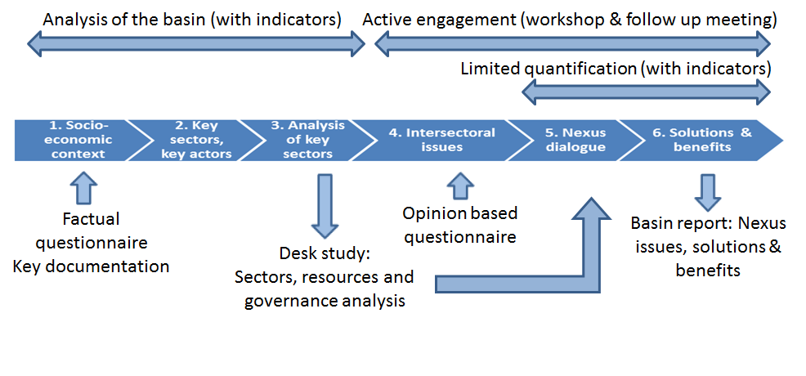
Nexus assessment methodology developed under the Water Convention
Provides for participatory intersectoral assessment at transboundary level informed by analysis, prepared in close cooperation with national governments
Adapts to the context and the issues specific to the basin
Applicable to surface water basins and aquifers
Notes:
The “nexus” is a potentially very appropriate approach to enhance resource efficiency and good governance in transboundary basins. The methodology developed for nexus assessments under the Water Convention has the objective of identifying trade-offs and impacts across sectors and countries and to propose possible policy measures and technical actions at national and transboundary levels to reduce intersectoral tensions. This is done jointly with policy makers and local experts. Compared to an Integrated Water Resource Management approach, the water energy food ecosystems nexus approach concurrently considers multiple sectors and their evolution. This offers the opportunity to better involve key economic sectors—energy and agriculture in particular—in the dialogue over transboundary water resource uses, protection and management.
The 5 basins to which the methodology has been applied so far – the Alazani/Ganykh (Azerbaijan, Georgia), Sava (Bosnia and Herzegovina, Croatia, Montenegro, Serbia and Slovenia), Syr Darya (Kazakhstan, Kyrgyzstan, Tajikistan, Uzbekistan), Isonzo/Soča (Italy, Slovenia), and the Drina (on-going, Bosnia and Herzegovina, Montenegro, Serbia) demonstrate that enhanced transboundary cooperation on the management of the basin resources will bring significant benefits. For example, promising cooperation possibilities with the energy sector have been identified.
These can be achieved through a broad range of actions – spanning institutions, information, instruments (policy and economic instruments), infrastructure (multiple use etc.) as well as international coordination and cooperation.
Some conclusions from the nexus assessments
- Integration is challenging: Essential that intersectoral coordination and consultation, consideration of different interests and integrated planning are happening. The best options vary and applying the nexus approach should build on the existing — e.g. multisector structures, intersectoral processes (SEA etc.), review policy and economic instruments, consultation on and coordination of investments …
- Achieving the Sustainable Development Goals (food security, water, energy etc.) will require taking into account intersector effects
- The Water Convention’s nexus approach — non-prescriptive, inclusive and indicative —provides a good basis for the identification of cooperation opportunities. It can provide for a broadening or restarting a dialogue
In the Syr Darya, the assessment involved:
Desk study
Multisectoral workshop (Almaty, 2-4 December 2014) for the countries organized with GWP in cooperation with FAO
Main intersectoral issues, some future scenarios, possible solutions jointly identified
Scoping level analysis
Participatory process: Consultations
Funded by Finnish Ministry of Foreign Affairs

Slide 6
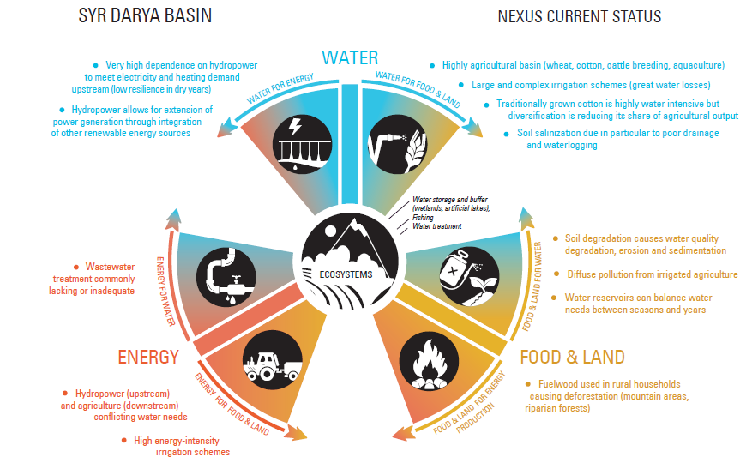
Nexus – the current status

Slide 7
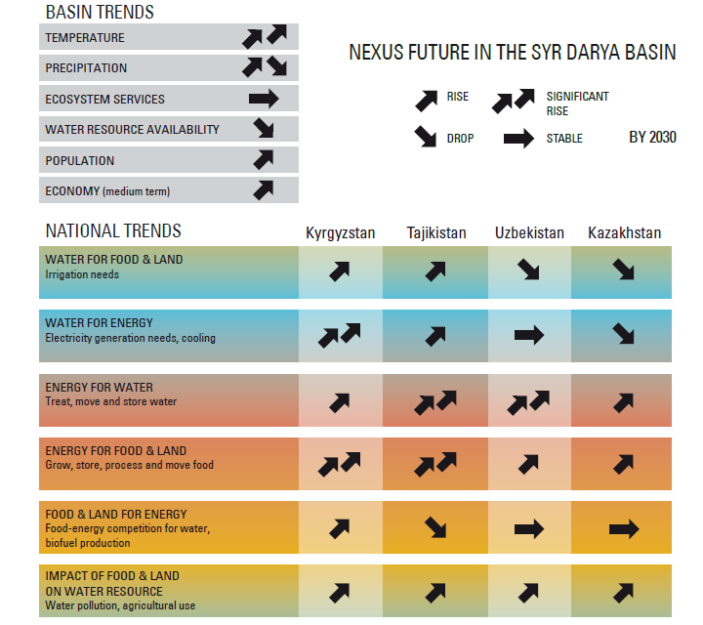
Nexus – future, trends

Slide 8
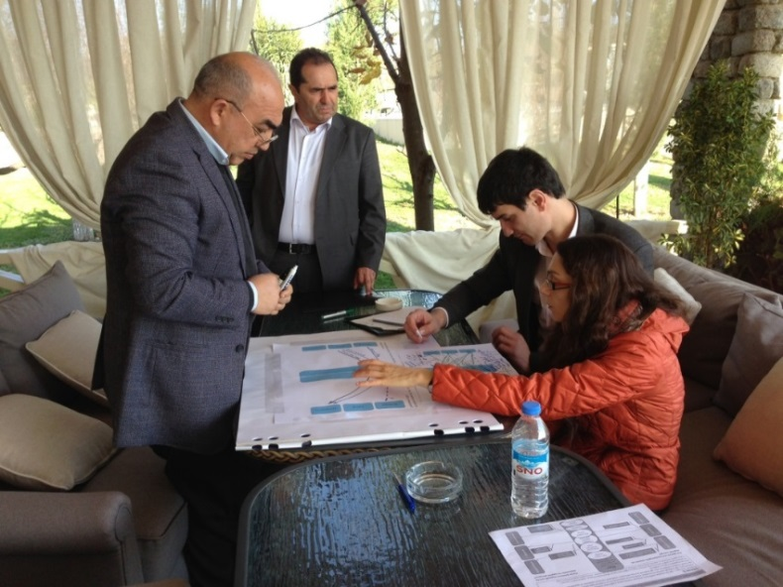
Main categories of solutions
The Water Convention’s nexus approach — non-prescriptive, inclusive and
indicative —provides a good basis for identification of cooperation opportunities
Institutions (intersectoral, multiple level governance, engaging resource users, responsibilities etc.)
Information (multi-sector information to support policy, assessing impacts across sectors, guidelines etc.)
Instruments (economic instruments, SEA etc.)
Infrastructure (built and natural – investments, operation, multiple use designs etc.)
International coordination and cooperation (sharing information, plans, good practices etc.)
Notes:
It can provide for a broadening or restarting a dialogue

Slide 9
Nexus opportunities in different basins vary (examples with energy focus)
Isonzo/ Soča Link RES generation to existing agriculture infrastructure (small hydropower, solar, biomass); improve river continuity and increase drought resilience | Sava Develop hydropower sustainably and integrate other renewable energies | Alazani/Ganykh Facilitate access to modern energy sources and energy trade; minimize impacts from new hydropower development; catchment management to control erosion | Syr Darya Promote restoring and vitalizing energy market, develop the currently minimal trade in agricultural products; improve efficiency in energy generation, transmission and use; improve efficiency in water use (esp. in agriculture)
Notes:
Alazani/Ganykh
Water-energy (hydropower), land-energy-water (biomass use, erosion/ sedimentation, hydrological flow)
Sava
Water-energy (hydropower); land-water (sediment management)
Syr Darya
Water-land-ecosystems (irrigation, salinization), water-energy (hydropower), land-ecosystems

Slide 10
Possible solutions/synergic actions identified in the Syr Darya basin (selected)
National development with co-benefits
Improving energy efficiency, reducing dependency on water for energy (diversification of sources)
Rationalizing water use (esp. in agriculture)
2. Broader sustainable development and national policy coherence
Developing mechanisms to identify and incorporate the wider nexus impacts in sector-based policy development leading to more integrated planning processes
Improving basin-wide monitoring, data verification and exchange, and knowledge-sharing, including joint monitoring (e.g. water flows and quality), joint forecasting
3. Accelerate national development by furthering cooperation
Improving intersectoral coordination at the basin level by increasing representation of and consultation with the relevant ministries
Developing a regional energy market and exploring opportunities for energy-water exchanges
Notes:
The Syr Darya nexus assessment has identified a menu of solutions to address specific inter-sectoral challenges in the basin and realise the potential benefits. Such a programme would encompass: (i) energy diversification in upstream countries to reduce dependency of hydropower in winter time and facilitate crop diversification; (ii) modernisation of energy and water infrastructure to minimise system losses; (iii) policy pacakges to increase energy and water efficiency (including pricing reforms, public awareness campaigns, and the introduction of energy efficiency standards); (iv) agricultural extension programmes to support crop-shifting and the adoption of sustainable resource management policies; and (vi) the development of regional energy and agricultural markets. Planning and implementation of such measures would also require institutional reforms and capacity development to facilitate basin-wide integrated resources planning both at national and bsin level.

Slide 11
Benefits of transboundary cooperation in the management of resources of the Syr Darya basin

Slide 12
Some insights for advancing nexus thinking in Central Asia
The nexus approach should build on the existing — e.g. multisector structures, intersectoral processes (such as EUWI National Policy Dialogues), review policy and economic instruments, consultation on and coordination of investments …
Ensuring a sufficiently broad participation of different sectors in a dialogue is necessary. How to find the common interest(s)?
With water as the only entry point risks blocking because getting fixed on (by default conflictual) water allocation. Energy (beyond hydro) and trade could offer constructive perspectives
Perceptions about the nexus/nexi vary. The complex issues require clear and accessible communication
Achieving Sustainable Development Goals (food security, water, energy etc.) will require taking into account intersector effects: Can this motivate action?
In the nexus assessments under the Water Convention, a methodology has been applied, an identification of issues and some solutions made jointly, and a model developed of the national energy systems to run scenarios – can serve further work and awareness raising
Notes:
The nexus approach is trying to reach out to the other sectors on a more equal footing
Can allow to take a fresh look at cooperation
The framework can also introduce a bias
The nexus assessment could
be oriented towards: (i) restoring cooperation; (ii) reviewing
the scope of cooperation or to identify new opportunities for
cooperation; (iii) quantifying interlinkages for setting priorities or for determining whether measures are required; or (iv) assessing
the appropriateness of a certain policy
Expectations need to be managed. Due to the broad scope of the
nexus assessment, the expectations of assessment outcomes are
highly diverse and therefore easily susceptible to disappointment.
The resources and time needed to develop a truly interactive
process and to actively coordinate with the different countries and
experts should not be underestimated.
It is important to be prepared for unpopular findings and
solutions. The results of a nexus assessment can challenge the
interests of one or more of the sectors or countries involved. It
is therefore important to have a robust institutional platform on
which to discuss them.
Integration is challenging: Essential that intersectoral coordination and consultation, consideration of different interests and integrated planning are happening. The best options vary and applying the nexus approach should build on the existing — e.g. multisector structures, intersectoral processes (SEA etc.), review policy and economic instruments, consultation on and coordination of investments …
Achieving the Sustainable Development Goals (food security, water, energy etc.) will require taking into account intersector effects
The Water Convention’s nexus approach — non-prescriptive, inclusive and indicative —provides a good basis for the identification of cooperation opportunities. It can provide for a broadening or restarting a dialogue
Building on the intersectoral-transboundary dialogue’s findings: Quantification of selected, jointly identified trade-offs and benefits to inform negotiation, cooperation, policy development. Prerequisite: Adequate data for meaningful analyses, fit-for-purpose support tools
Result of the assessment may be controversial to a sector or a country; the process design and institutional framework important to ensure acceptance
The improvement opportunities are to some degree context-specific and the cooperation situation — trust, mandates etc. — influences what can be done. Need to manage expectations!
Balance between focusing on key issues and being open to the unexpected
Resources
Reports:
Nexus assessment methodology and the basin case studies: printed in Russian, expected in French in March
Syr Darya in English in January 2017, expected in Russian in March
Sava in January 2017; press release circulated in the local languages
Policy briefs:
Summary brief on the basin assessments 2013-2015
Sava nexus assessment
Brochure/policy document:
Nexus and renewable energy – building on the basin assessments, expanded with good experience (prepared for the 8th Forum on Energy for Sustainable Development)
All publications available from: http://www.unece.org/env/water

Slide 13
Some perspective areas for further work
Documentation (reports, analysis, briefs) from the UNECE nexus work can substantiate the dialogue and contribute to capacity building
In-depth assessments of governance across sectors at the national level would be valuable, as well as a review of how selected intersectoral processes (e.g. SEA) are applied or what the perspectives for their use are in the countries
Carry out an assessment of available water resources, saved water, water and land productivity, including a critical descriptive and quantitative analysis of the potential effect of measures in improving efficiency of irrigation and improvement of land reclamation. To complement the energy analysis done; the model can be used to assess impacts of some investments.
Evaluate costs and benefits of selected nexus solutions prioritized by the countries
Fora for awareness raising, capacity building, sharing experience, extending the dialogue: EUWI National Policy Dialogues, SPECA Thematic Working Group etc.
Facilitation of bankable projects. In renewable energy, UNECE Group of Experts on Renewable Energy) is promoting this in a session at the Forum on Energy for Sustainable Development in Astana (11-14 June 2017)

